Slide 1
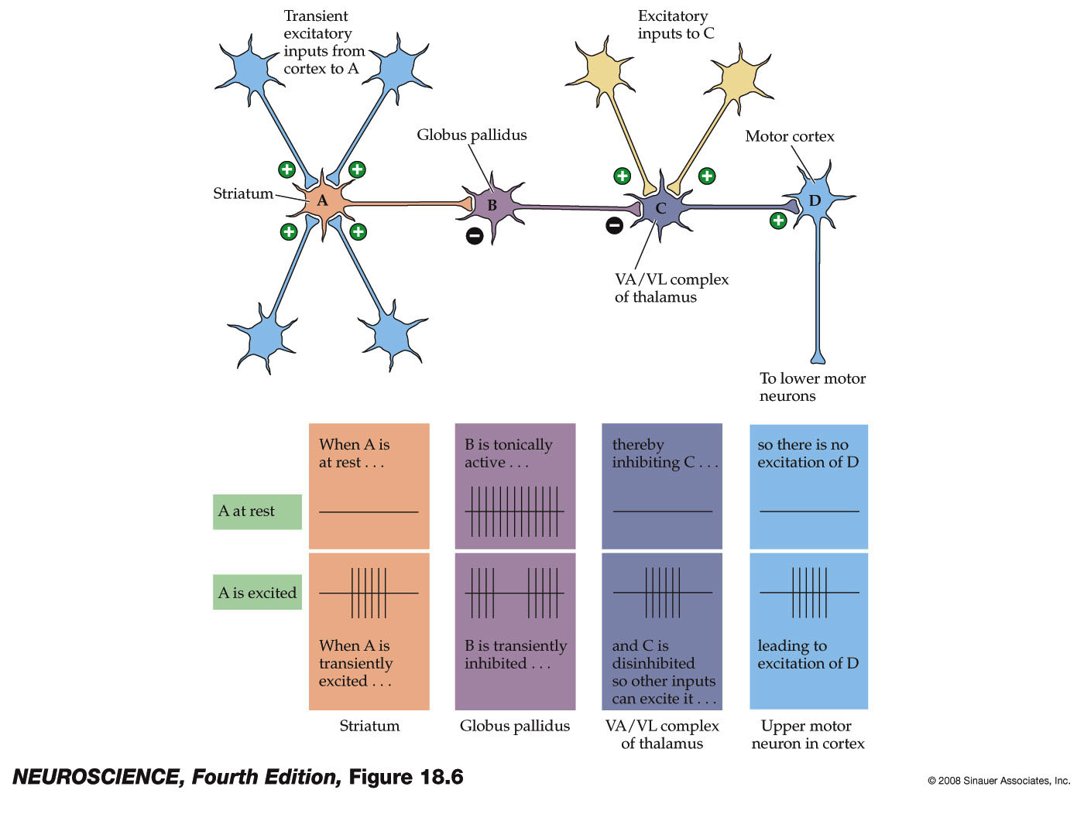
Disinhibition
When cortical activity increases and activates the striatum, the GP is inhibited, removing inhibition of the thalamus.
Disinhibition of the Thalamus allows the Thalamus to excite cortex and for voluntary movements to begin.
Tonic = continuous
Transient = sporadic

Slide 2
Projections from the BG
GABAergic MSNs in the striatum
Substantia nigra pars reticulata (SNr)
Globus pallidus
Direct pathway: Striatum → GPi
Indirect pathway: Striatum → GPe

Slide 3
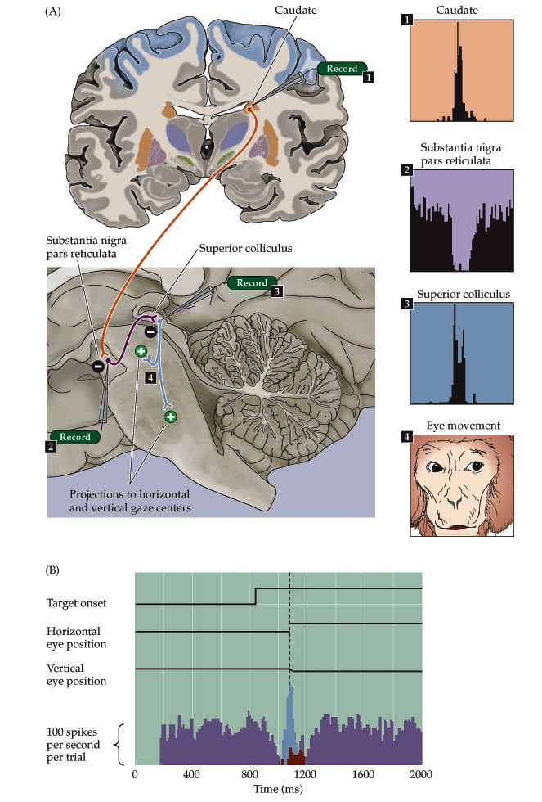
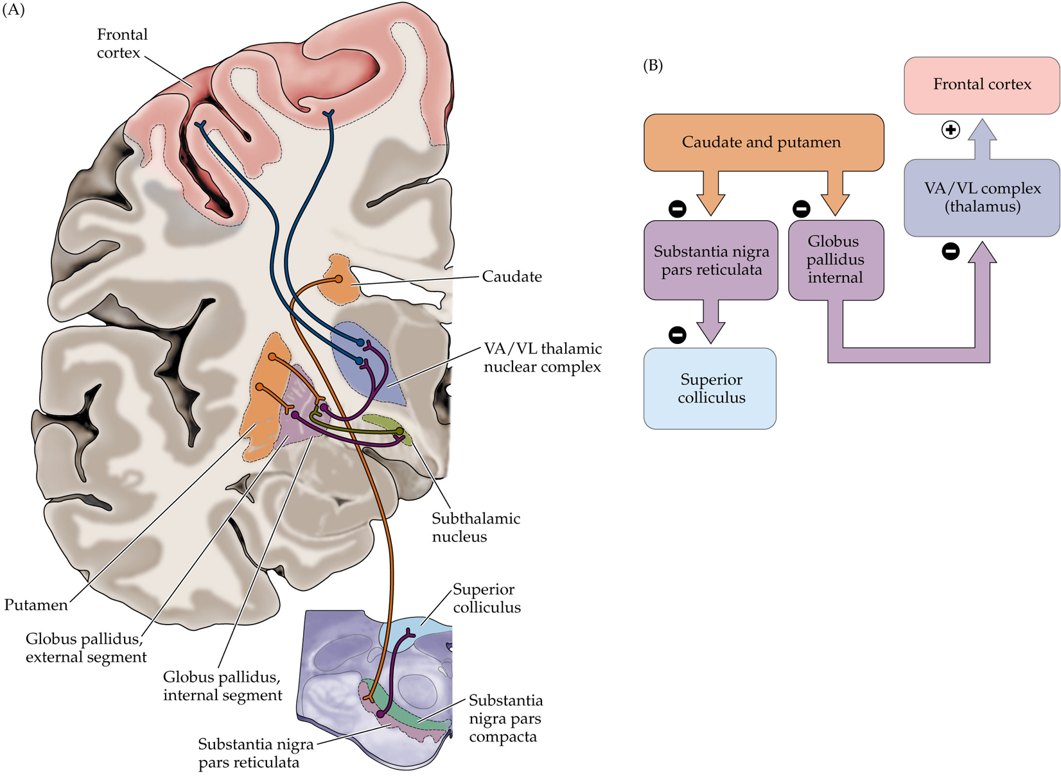

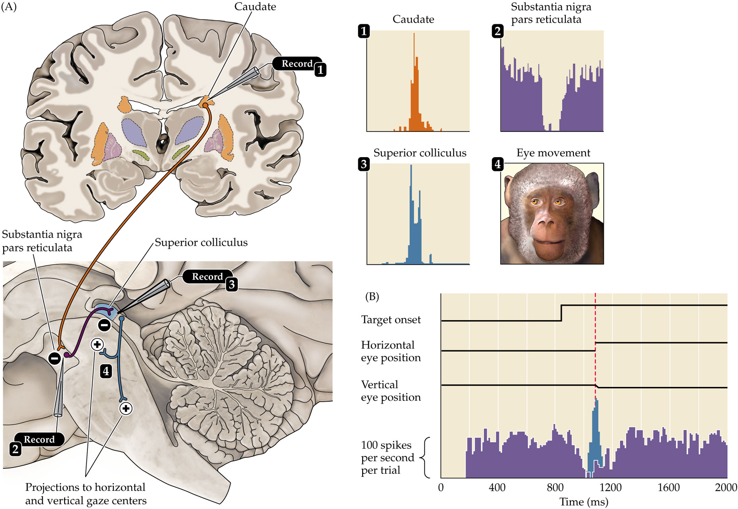
SNr Pathway
Cortex excites MSNs in the caudate.
The caudate becomes active
  ↑ GABAergic transmission to SNr
SNr normally tonically inhibits the SC.
  When inhibited, the result is disinhibition of the SC.
  Disinhibition of the SC allows saccadic eye movements.
The SNr also has projections to the Thalamus
  When disinhibited, excites the frontal eye fields

Slide 4
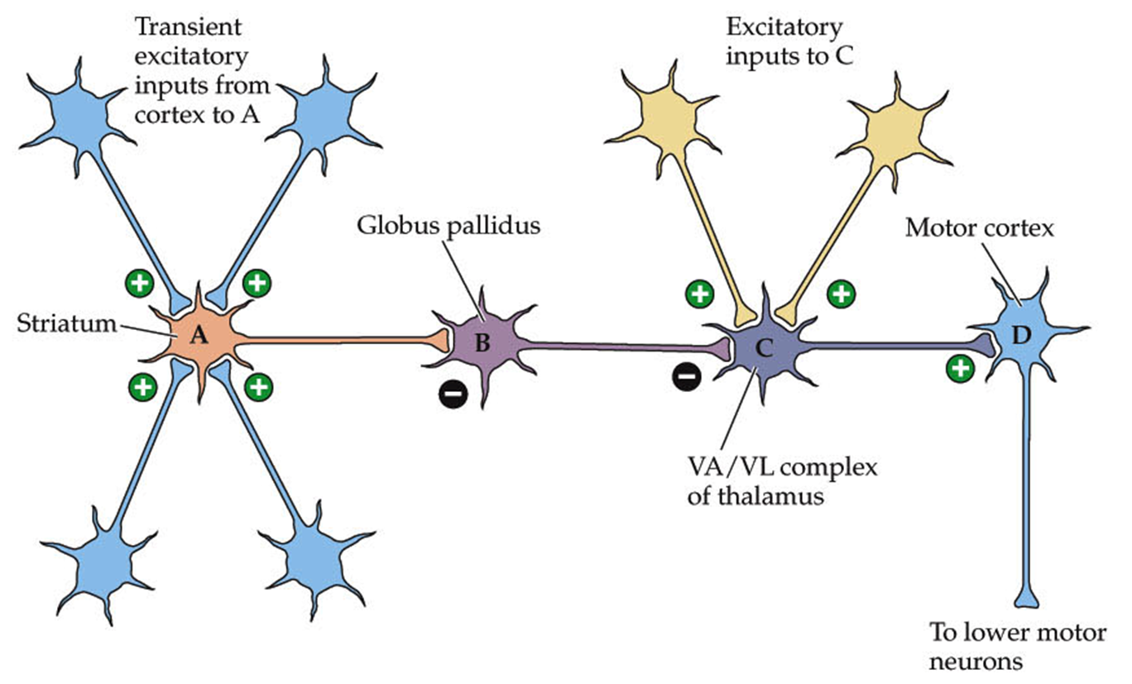
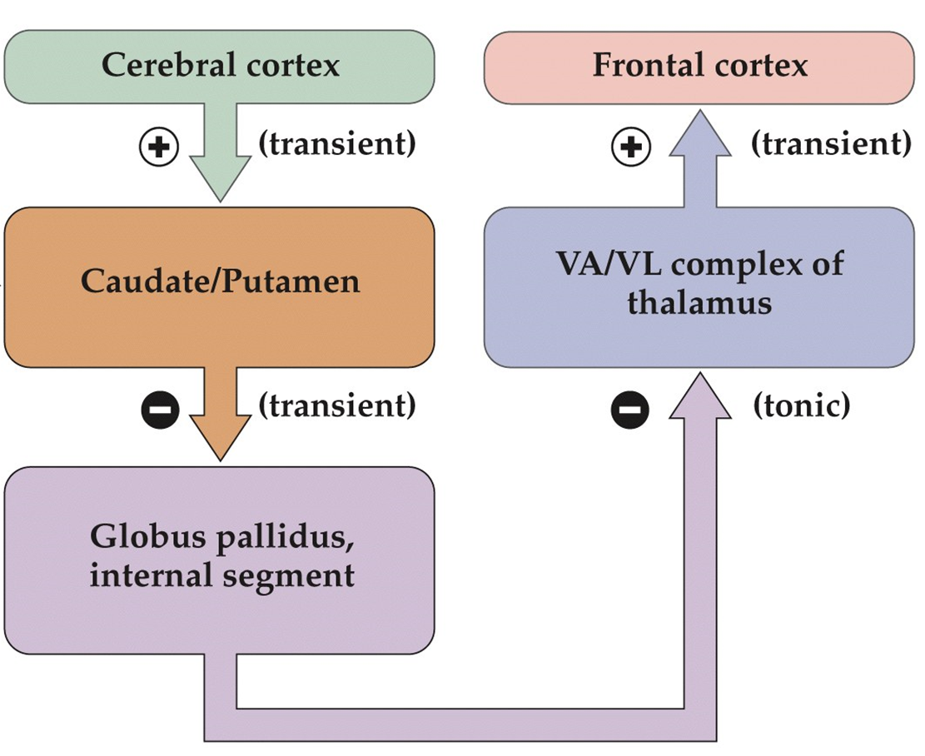
GP Direct Pathway:
Selection of Intended Movement
Cortex excites the dorsal striatum
The dorsal striatum inhibits the GPi
  The GPi normally tonically inhibits the Thalamus
  When inhibited, the result is disinhibition of the Thalamus
Increased activity of the Thalamus excites motor cortex

Slide 5
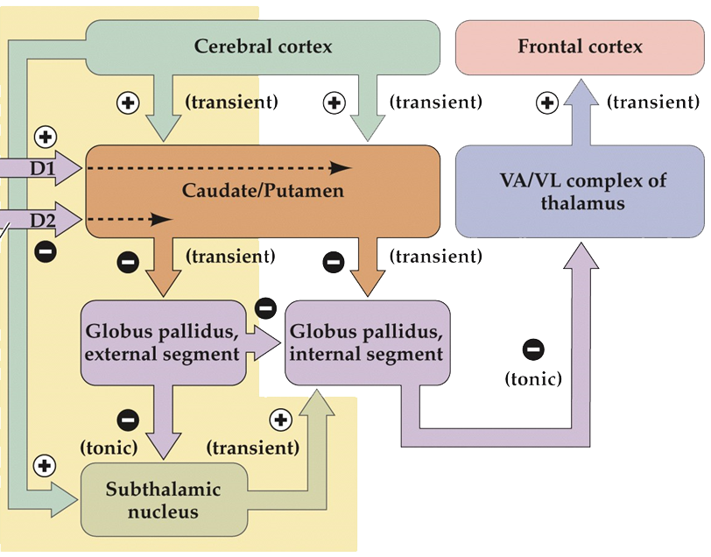
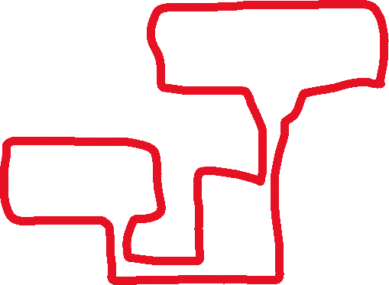
GP indirect pathway: Suppression of Movement
Excited dorsal striatum inhibits GPe
  Gpe normally tonically inhibits the subthalamic nucleus and GPi
  When inhibited, the result is disinhibition of the subthalamic nucleus and GPi
The subthalamic nucleus excites GPi
Excited GPi inhibits the thalamus
Decreased activity of thalamus = decreased activity of cortex

Slide 6
The direct and indirect pathways operate in complementary ways
Activity in the direct pathway
disinhibits the thalamus.
Activity in the indirect pathway
inhibits the thalamus.
increases cortical output.
selects intended behaviors.
decreases cortical output.
suppresses competing behaviors.

Slide 7
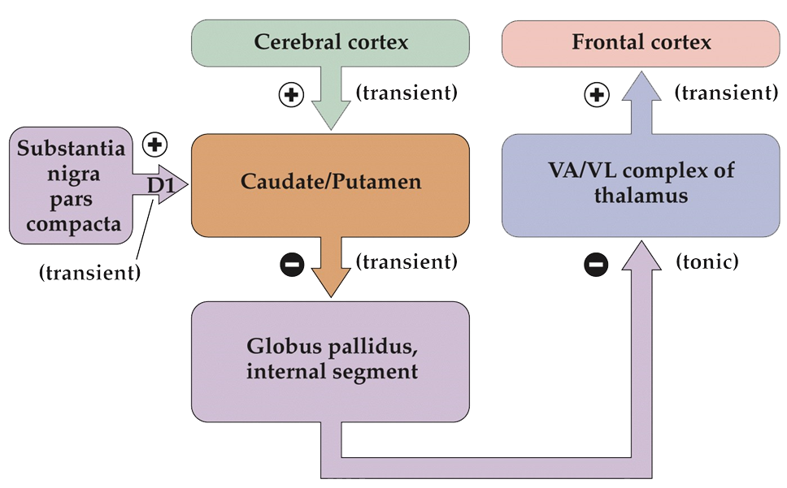
Dopamine enhances activity in the direct pathway

Slide 8

Activity in the indirect pathway is suppressed by dopamine

Slide 9
Overall Dopamine promotes disinhibition
 | No DA | + DA
Direct (releasing behavior)
Indirect (suppressing behavior)

Slide 10
